Slide 1
Use of Franchisee Model in Linkage. MicroLead Tanzania Regional Workshop April 19, 2016 Joyce Kulwah, CARE International in Tanzania – Microlead Expansion Program Program Initiatives Manager

Slide 2
MicroLead Expansion Program:
Under MicroLead Expansion Program CARE is working on both ends, demand and supply, to increase financial inclusion in the Kilimanjaro region. Rather than scaling up a typical MFI, Care would attempt to downscale a financially viable mainstream bank to offer services to poor families. These families are in remote areas of Kilimanjaro region and do not have access to financial services either from banks or MFIs.
Project aims at providing 100,000 low income, financially excluded people access to informal financial services through VSLAs, as well as enabling 50,000 access to formal financial savings products through linkage of 2000 VSLAs to MCBL and NMB.

Slide 3
How a VSLA works
VSLAs are self-selected, community based, and require little to no infrastructure to form
Savings Group
How It Works
Groups of 15 to 30 people (typically women), meet on a weekly or biweekly basis to save into a common fund.
The common fund is used to support loans within the savings group as needed, with the loan interest used to provide a return on the invested savings.
At the end of a set cycle (typically 9-12 months), the savings, with accumulated interest, is “shared out” amongst the group members and a new cycle begins.
Savings
Loans
Why it Works
VSLAs are relatively easy to establish and require little to no infrastructure
A knowledgeable facilitator, a lock box, and minor tools are all that is required to get started. Groups continue to operate well past their first share out, with many operating for 4+ years
VSLAs are seen, even for the very poor and for those living far from bank branches, as a powerful strategy to create savings and borrowing capacity.
Notes:
As we have already seen, this project works mainly through formation, training and linkage of VSLAs. Let us hereby take a moment to see briefly how a VSLA works.

Slide 4
……Now Why do we Link?????
Lack of long-term savings option in VSLAs
Safety of funds in the box
Loan amounts from VSLAs are small and for shorter duration
Inflexible to allow larger savings
Social fund in VSLAs too small to cover larger risks
Inability to extend loans closer to the share-out time
Not amenable to seasonal cash-flow of households
Long term sustainability of VSLAs

Slide 5
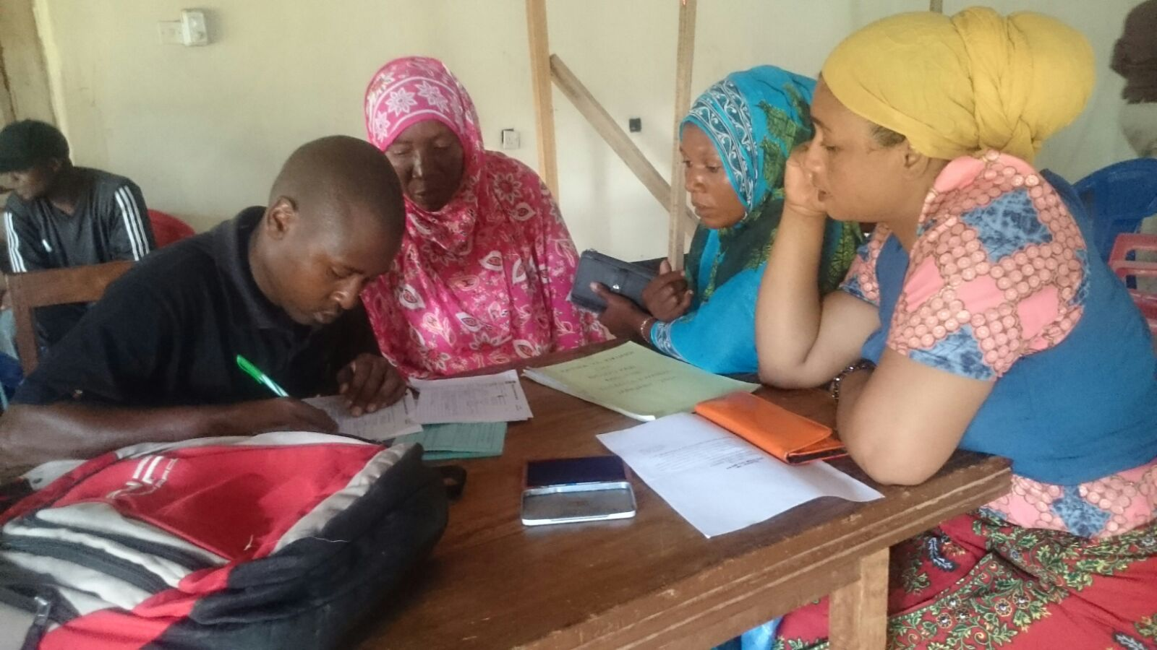
Who do we link?
Our target group is financially excluded women and girls from rural communities.
Notes:
We work in Seven districts of Kilimanjaro region. These are Hai, Siha, Moshi Urban, Moshi Rural, Rombo, Mwanga and Same. We link VSLA members after a thorough training from our CBTs and Franchisees

Slide 6
...and How do we Link?
MicroLead Expansion Program use Franchisee model in Linkage where the program contracts franchisees to perform program activities such as formation of VSLAs, Training and Linkage.
Linkage Process:
VSLA Formation
Training on FE and Linkage
Budgeting
Importance of Linkage
Rating To determine Readiness
Preparation of KYC
LINKAGE
Loan Management
Use of MNO
Financial Status
Record Management
Loan disbursement / portfolio
Identity Card
Letter of application for account opening
Identification of Signatories

Slide 7
Petro Bundala (Franchisee from Same providing financial education to VSLA members .

Slide 8
Key Project Implementers Roles & Responsibilities
Notes:
To date the program works with 168 CBTs and 15 Franchisees.

Slide 9
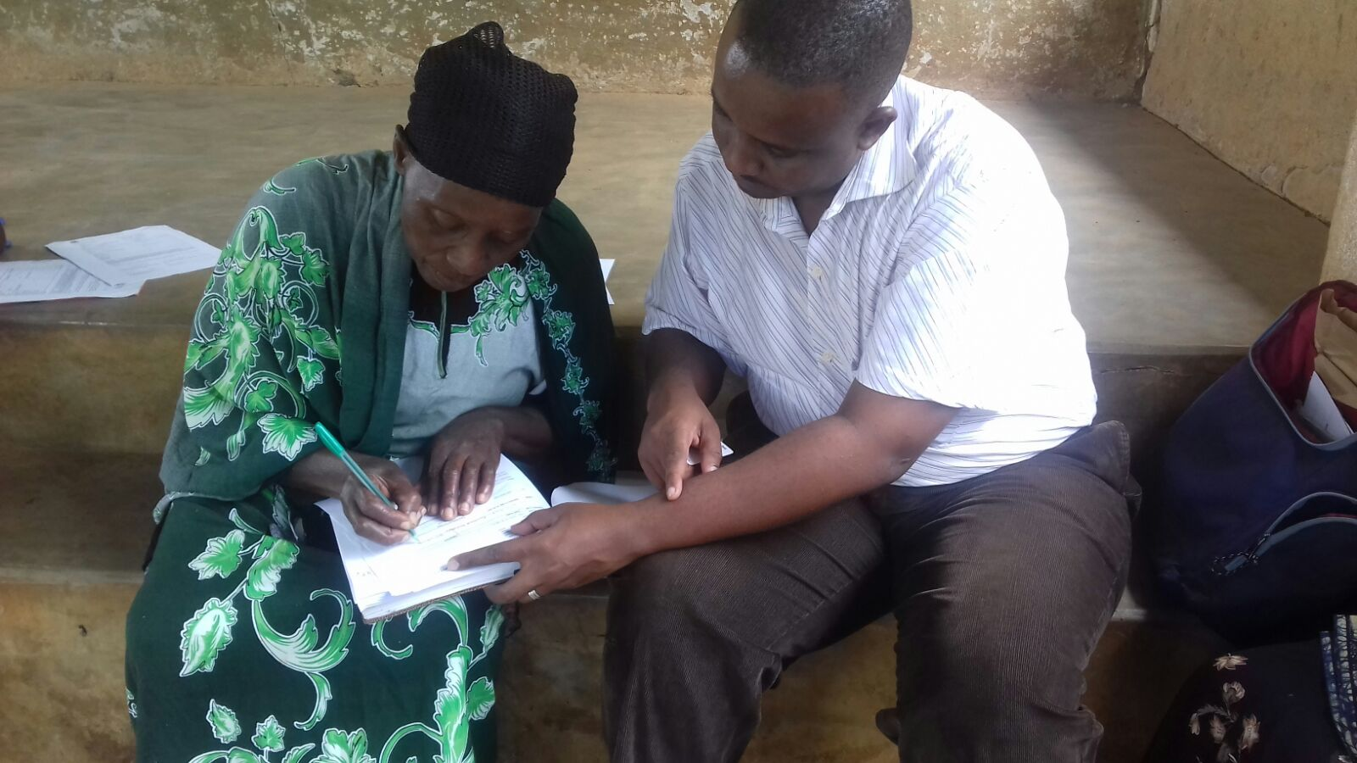
Idan Kessy ( MLEP Program Officer ) facilitating linkage process.

Slide 10
Through Franchisee Model MLEP achieves ……
Formation of 3,357 VSLAs, Training of 3040 VSLAs On Financial Education and Linkage of 946 VSLAs
Ensured sustainability and community ownership of the program initiatives since key actors (Implementers) are the Franchisees and CBTs who comes from respective communities (as compared with direct implementation through Program Officers)

Slide 11
Achievements Continue…
Greater incentives as franchisees and CBTs have stake in the business. Stipends are paid on performance bases.
Promotes capacity building of franchisees and CBTs to become ideal on ground implementers of other program initiatives.
In partnership with NMB and MCB we managed to design, develop and deliver appropriate products for VSLAs.
Engagement with other MFI (NMB) helped to reduce distance and cost among VSLAs. Eg VSLAs from Hai used to travel 35 Km to MCBL Moshi Service Centre.
Mwananchi Day and Demand Creation events helped the program create awareness on bank products hence speed up the linkage process.

Slide 12
Pain points Encountered..
-
Time taken by VSLAs to decide whether to link or not to link. The program has initiate demand creation campaigns to rise community awareness on importance of utilizing products provided by the banks
Poor infrastructure to reach the rural community. The program in collaboration with MFIs conduct linkage activities in respective areas where account opening is done on site
Incomplete of bank required documentation (KYC). The program provides checklist of all required documents and close follow up before account opening day.
Absence of reliable Mpesa, Tigopesa and Airtel money agents who are able to serve VLSAs. Eg Kawaya Village in Hai District where a group needs to travel to Moshi for deposits.
Too much documentation and long procedures for account opening and loan processing.

Slide 13
..We are devoted to serve our rural communities, however remote. Idan Kessy (MLEP Program Officer) with MCB staff taking of to Kitoghoto village (Mwanga) for Account opening for Account opening

Slide 14
Lesson Lent…..
Proper Financial education to the groups speed up linkage process
The program have an opportunity of encouraging group members to pay CBTs Fee for Service to ensure sustainability.
Sustainability and scalling up of VSLAs acces to formal financial services also dépends on presence of compatible government policies.

Slide 15
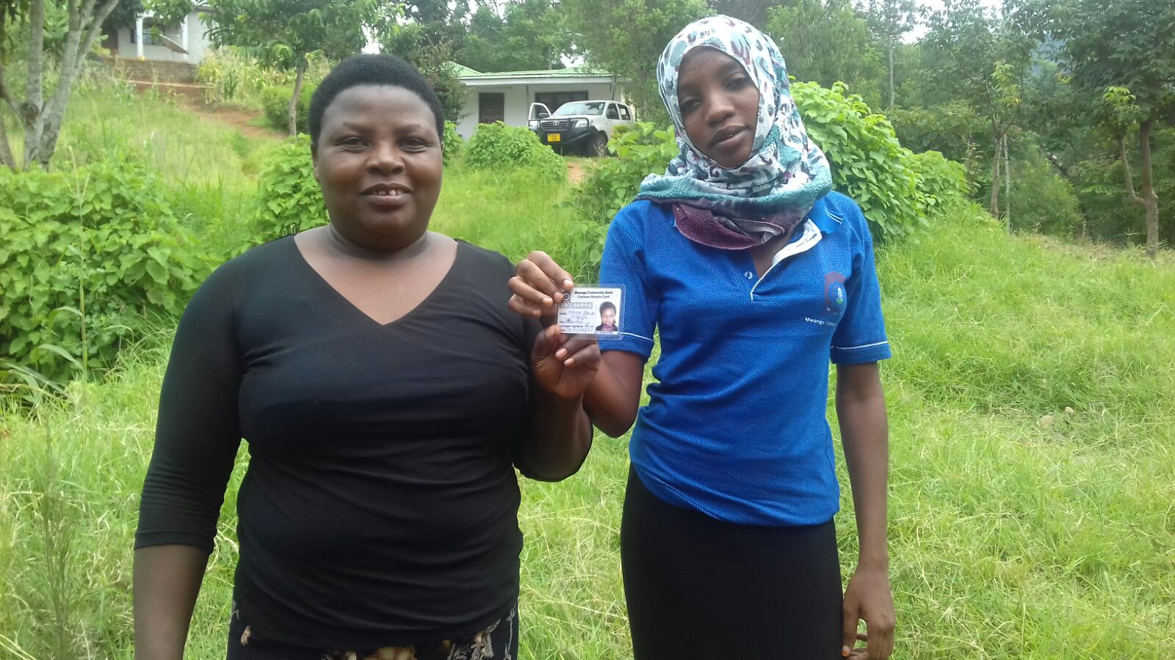
…… thank you
Notes:
Here I will review the AA developed linkage process and then go in depth with the history of our linkage relationship with MCB.

