Slide 1
I2F: From Informal to Formal
Harnessing the potential of technology to drive access to finance for the last mile in Africa
FfD Forum Side Event
25 April 2018

Slide 2
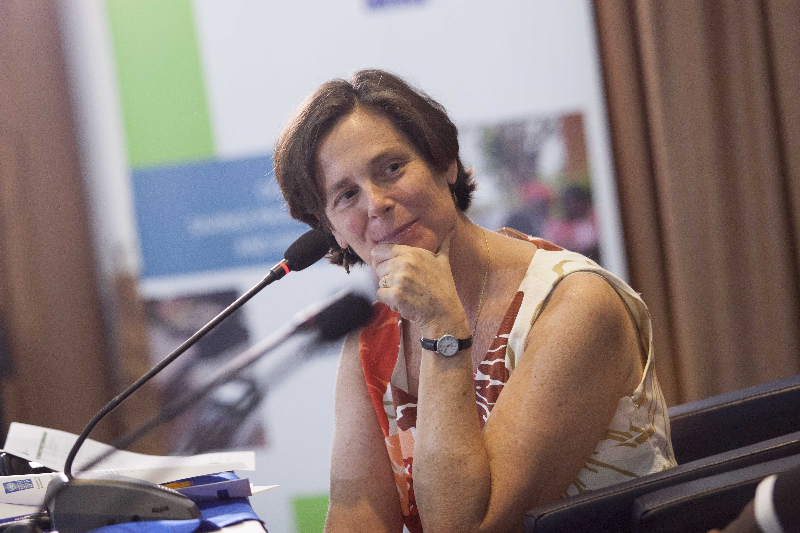
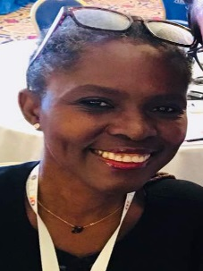
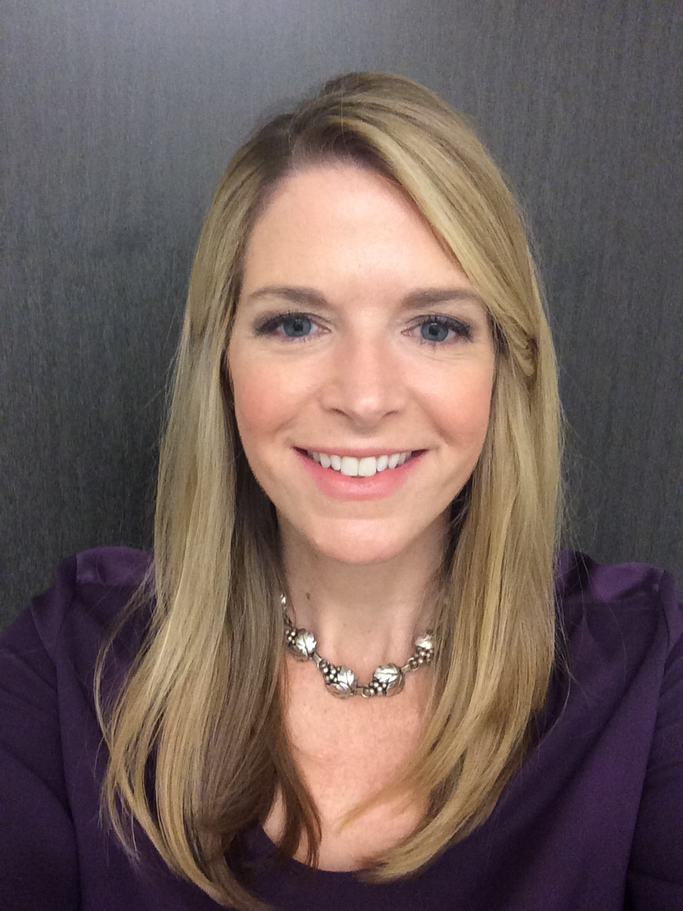
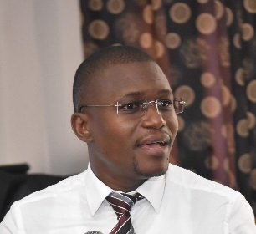
Introduction of Panelists
Pamela Eser,
UNCDF
David Symington,
UNSGSA
Clarissa Kudowor,
Bank of Ghana
Cathleen Tobin,
Women’s World Banking
Valère Houssou,
ALIDé
Notes:
Intro to Topic by UNCDF
UNSGSA
Bank of Ghana
Two partners supported by UNCDF MicroLead: WWB and Alide

Slide 3
Why I2F?
Help achieve SDGs: “reach furthest behind first”
Help implement AAAA, domestic resource mobilization
1.7 billion people still have no account at a financial institution or mobile money provider
Majority of these unbanked are women, in rural areas
Represent potential savings of $116 billion/year
DFS, agent networks, informal savings groups make access possible
Innovations in fin-ed and dig-lit using tablets and SMS platforms, HCD→address usage
Ability to harness data
Notes:
FI helps accomplish a number of the SDGs.
Research shows savings are the most important financial service to bring people out of poverty and keep them out of poverty.
But SBDM is difficult for FSPs to do profitably…or is it?

Slide 4
MicroLead Programme Lessons Learned
Challenges to address to reach the Last Mile
    Access: Cost, Business case
    Usage: Dormant accounts
    Quality: Transparency, Financial literacy, Digital literacy
Breakthroughs
    ADCs—agent networks→ female agents
    DFS—mobile money, digital wallets
    Savings groups—reach numbers, reach women, WEE
    Human-centered Design and Behavioral Economics
    App and SMS-based fin-lit/dig-lit
Notes:
But even with these breakthroughs, FSPs are having difficulty reaching rural populations and women in particular. Examples.

