Slide 1
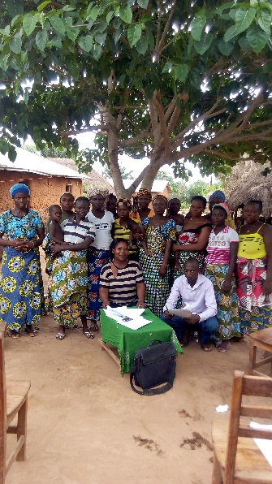
Valère L. HOUSSOU,
CEO, ALIDE houssoul@yahoo.fr
From
Informal to Formal
Harnessing the Potential of Technology to Drive Access to Finance for the Last Mile
New York, April 25 2018
Notes:
Commentaire

Slide 2
Sommaire
1
The Context of Bénin
2
ALIDE
3
ALIDE’s Experience with Linkage
Activities Completed & Results
4
5
Challenges and Lessons Learned

Slide 3
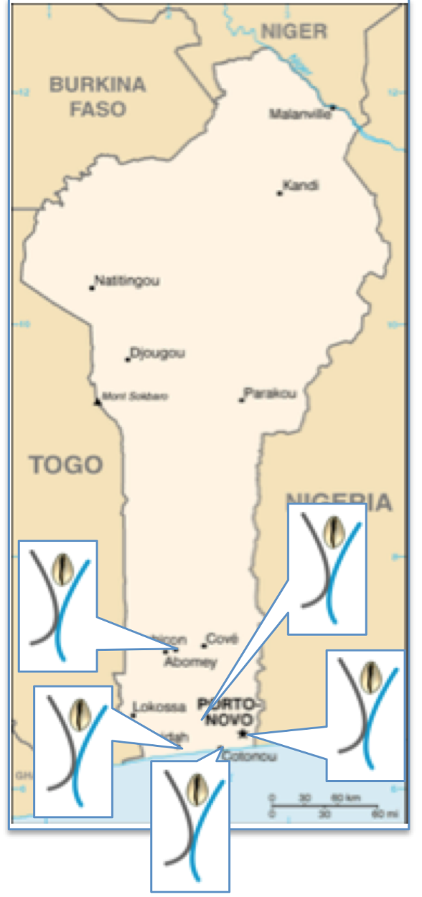
The Context: Bénin
Population: 11.8 million (2016)
Formal Financial Services: 15 banks, 54 MFIs, and 2 MNOs
More than 1/3 of adults do not own their own telephone
20% of adults are financially included and 11% are digitally included, with an overall inclusion rate of 33%
Women (84%) lag behind men in all aspects of financial inclusion

Slide 4
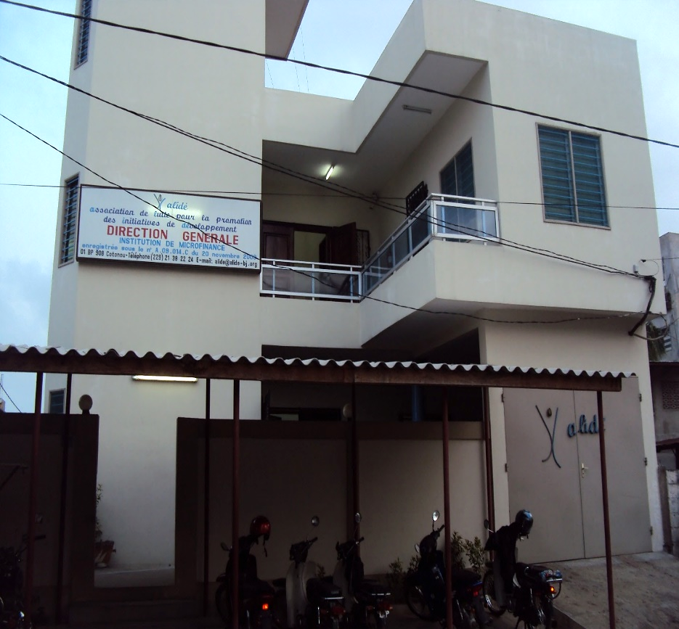
ALIDE
Formal MFI created in 2006
12 branches, 4 located in rural areas
Coverage of 6/12 departments
Offer both savings and credit
Target underserved peri-urban and rural populations of whom 85% are women
Outstanding loans: 6 985 000 USD
Savings: 4 200 000 USD

Slide 5
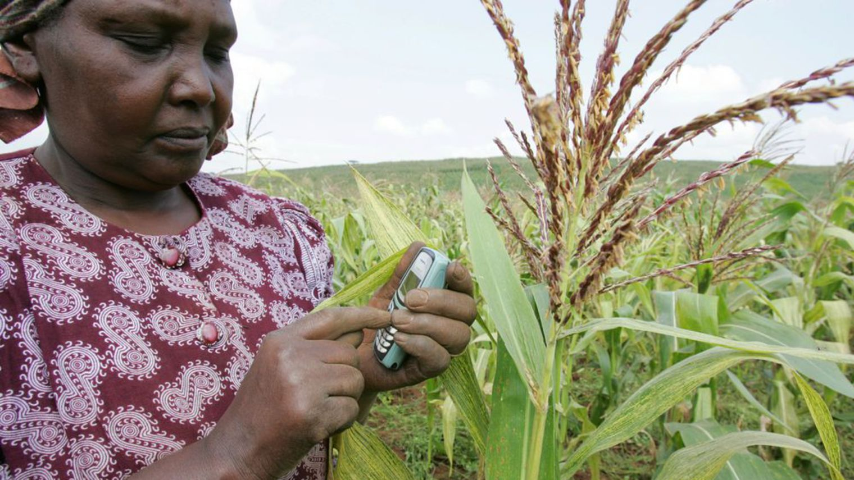
Experience in Savings Group
Linkages
2-year pilot in a rural area
Of the 18 000 potential female clients 67% have a phone
Our goal is to link 120 savings groups to ALIDE using our own platform

Slide 6
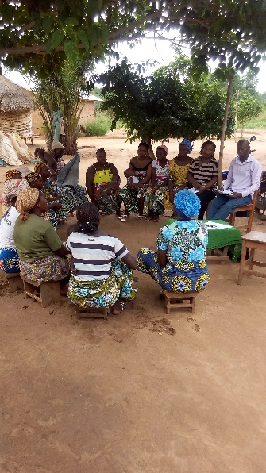
Activities Completed
Market research study
Design of DJIDEMI savings product
Platform configuration
Development of financial education module for groups
Development of financial education to be delivered via radio
Creation of local agent network

Slide 7
Results
No of Accounts Opened | Number of Women Reached | Total Savings (in USD)
219 | 4 965 | 9 600

Slide 8
Challenges
Choosing the platform and designing the interface
The length of the project is very short
The absence of (or weakness of) an internet connection in the areas targeted for the project
Low confidence levels of group members because they have been robbed by other institutions in the past
Low level of savings collected by ALIDE

Slide 9
Lessons Learned
Know-how in choosing a technological solution
High need for financial literacy on the part of beneficiaries
High need of credit / loans for groups
The need for support of an NGO to facilitate the linkage between savings groups and ALIDE

Slide 10
Perspectives
Refining the product and the business model
Creation and establishment of an agent network
Seeking out new strategic partnerships
Scaling up the experience from the pilot in order to reach 18 000 women in the target areas

Slide 11

Partenaire

