Slide 1
Financial Services Access and Agency for Women and Girls
Senegal Country Assessment Workshop
16 November 2017
Dakar
Notes:
Thank you, Mathieu, for that welcome. And now I would like to add my welcome as well as my thanks. Thank you so much for being here today to hear about the results of the country assessment carried out by UNCDF with the support of Dalberg Global Advisors on access and agency issues faced by women and girls in regard to financial services, and in translating their use into greater economic empowerment.
We are grateful to you not only for your presence today and willingness to join us the analysis of the findings and recommendations that will lead to a programme design for here in Senegal, but also to programmes in Bangladesh, Ethiopia, Myanmar, and Tanzania. We hope that this will be valuable for you too, not only for the insights provided and recommendations offered, but also to think about your potential engagement with the initiative as a collaborating partner—whether as a partner in implementation, a recipient of an innovation grant, a beneficiary of capacity building, or a funder, or simply as a complement to your own strategy and work. You will have plenty of opportunities to engage and talk with us during the workshop—particularly in the second portion after the presentation. And additionally we welcome follow up from you with our country team based here in Dakar, or with me based in New York at UNCDF HQ.
First, however, let me introduce and acknowledge the team from Dalberg Global Development Advisors who will be facilitating the workshop or have supported it. First, Marieme Diallo, whom a number of you know, as she carried out the Country Assessment here in Senegal under Project Manager, Tania Beard, and Partner, Madji Sock. In addition, there were a number of other Dalberg staff who contributed greatly to the development of the Country Assessment Toolkit, as well as the assessments in Senegal and the other four countries.
Next, I want to acknowledge our in-country colleagues and team whom many of you know and have made this possible. Maria Perdomo—leading our work with youth in Senegal and elsewhere in Africa. Sabine Mensah—leading our DFS work in Senegal and other West African countries. Jean Pascal Mvondo—leading BTCA engagements with Senegal and with other Francophone countries. And I would like to take this opportunity to thank other colleagues for all the support they have provided relating to the country assessment and/or this workshop: Arianna Gasparri, Elisa Benevelli, Aminata Gueye, and Bery Kandji. Not to mention the support of our consultant, Katherine Miles who is cheering us on from her base in the UK.

Slide 2
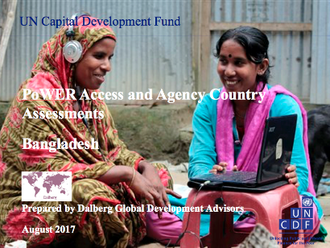
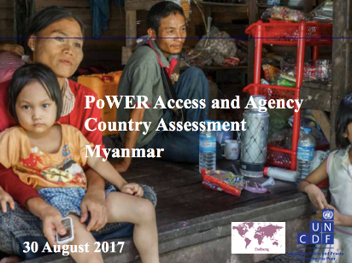
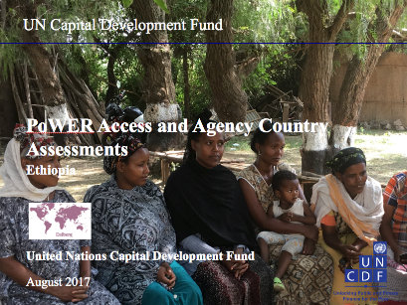
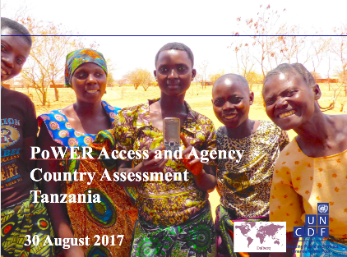
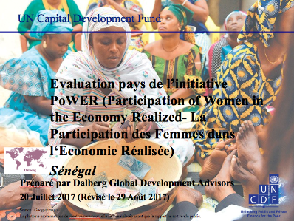
Senegal Financial Services for Women & Girls Country Assessment Workshop
Objective:
Share and validate Tan country assessment findings and insights on key constraints and enablers of women and girls’ access, usage and control of finance across supply, demand and the enabling environment and the cross-cutting socio-cultural context.
By the end of the workshop, participants will have:
Been exposed to country assessment toolkit and how use for complementary insights to other studies and data and inform programme design and partnership strategies.
Heard key findings from country assessment report.
Validated findings and helped prioritized recommendations for action.
Participants:
Representatives of multiple stakeholder groups including government (policymakers, line ministries, regulators), financial service providers (banks, digital financial service providers, microfinance organizations), private sector and business associations, civil society representatives, researchers, and bilateral and multilateral development agencies.

Slide 3
Senegal Country Assessment Workshop Agenda
Agenda 16 November 2017
8:30 | Registration
9:00 | Welcome
9:05 | Introduction to the UNCDF PoWER Strategy
9:20 | Country Assessment Findings and Q&A
10:30 | Coffee/tea break
10:45 | Prioritization of constraints to women’s and girls’ financial inclusion
11:05 | Discussions on prioritization of UNCDF recommendations to address each of the identified constraints
11:45 | Plenary feedback on results of sub-group discussions on prioritization
12:15 | Closing remarks
12:30 | Lunch

Slide 4
Global PoWER Strategic Goal 2018-2022
By 2022, nearly two million women and girls, in ten countries, starting with the five LDCs of Bangladesh, Ethiopia, Myanmar, Senegal, Tanzania, will have improved awareness of, access to, use of and control over financial products and services responsibly provided by diverse and sustainable service providers in a well-regulated environment. In addition, the enabling environment and the socio-cultural context for greater access and agency for women and girls will be improved in these countries.
The Global PoWER Strategy Theory of Change (TOC) assumes that this will contribute to more inclusive financial markets that drive women’s and girls' economic empowerment and participation

Slide 5

The PoWER Empowerment Framework
Inspiration drawn from: World Bank, M4P, Care, ICRW, Gates, DCED, Oxfam
3
…Leading to their economic empowerment
…Drive financial inclusion for individual women and girls….
1
2
Economic
opportunities
Interventions across three spheres of influence, adapted to women’s lifecycle needs and economic roles….
Financial inclusion
Access, usage,
agency¹
Agency
Resources
Enabling environment
(policy, regulation, laws)
Demand
for financial products & services
(households)
Supply
of financial products & services
(financial markets)
Other drivers of women’s economic empowerment²
Socio-cultural
context
(gender norms)
Delayed marriage
Work opportunities
Property and assets
Family planning
Education
Alleviation of unpaid care
[1] The definition of agency in the financial inclusion context refers to controlling the benefits of financial product & service use. [2] A recent Gates Foundation study highlighted 6 other key drivers of WEE.
Notes:
Spheres of influence:
Enabling environment: The existence and implementation of laws, regulatory frameworks, and services that the state provides, which are influenced by international regulations.¹ These in turn shape the business environment in which market actors operate. This sphere of influence covers elements of indirect relevance to FI e.g. inheritance law
Supply: The suppliers of financial products and services, and supporting market actors. Markets can be influenced and shaped by policy, infrastructure and social norms.
Demand: Women and girls’ demand for financial products and services is shaped by intrahousehold decision-making, behaviour, division of labour and lifecycle needs. e.g. time poverty that women face as a result of women’s unpaid care work
Socio-cultural context (cross-cutting): Norms resulting from shared beliefs that shape social interactions and define gender roles. These are enforced by informal social sanctions. Such dynamics underpin biases across each of the other spheres and influence women’s participation across each cog.
Financial inclusion
Financial inclusion is achieved when all individuals and businesses have access to and can effectively use a broad range of quality, adapted financial services that are provided responsibly, and at reasonable cost, by sustainable institutions in a well-regulated environment.
Three critical components to consider when measuring Financial Inclusion are access, usage and quality.¹
Women and Girls
The gender identity to which a person holds, which is typically identified by their biological sex. The distinction between women and girls is age; girls fall between the age of 10 and 24.
Women’s economic empowerment (WEE)
Women’s economic empowerment is achieved when women and girls, first and foremost in LDCs, gain the resources and skills to equally access economic opportunities in the market, as well as the agency to use and control the benefits of participating in the market. This is enabled by policy and infrastructure, equitable markets and social norms that allow women and men to reach their potential.

Slide 6
During a woman’s life, she goes through multiple life cycle transition stages
Adolescent girl¹ life stage
These transitions are not linear nor exhaustive. A woman’s life cycle will ultimately depend on country-context
Adolescent and/or adult woman life stage
Primary to secondary school
Ageing to death
Secondary to higher education
Adult woman life stage
Spousal death²
Education to employment
Key life cycle stages of transition for women and girls
Due to conflict amongst other reasons, ideal/aspirational progressions between stages may be quite different from the reality that many women and girls face³
Caring for ageing/infirm relatives
Household contributor to manager
Migration induced household changes
Marriage
Girls may have different starting points, may skip stages or may transition between stages at different ages e.g. out-of-school girls would skip the first three stages
Building a family
¹ Adolescent girls are defined as those in the 10 to 24 year age group. ² This could include other family members dying. ³ In Ethiopia for example, some girls may be forced to migrate for marriage.
Notes:
It is not very helpful to talk about the “women’s segment”—women are half the population, and their needs are as differentiated as men’s! In the PoWER empowerment framework, we look at women and girls from two different perspectives to help us better understand their opportunities and constraints in order to consider approaches and interventions that can contribute to their greater economic empowerment. These include a life cycle analysis and considering their different economic roles.
In terms of life cycle transitions, depending on country contexts, these stages may happen at different ages and not in the order presented, but at the global level, each of these transitional life stages raises distinct financial needs. In the life cycle analysis, there are both biological life cycle stages (menstruation, pregnancy, child birth, breastfeeding, menopause, death) and social aspects (transition to secondary school, from being single to being married, etc.).

Slide 7
Women’s financial needs are determined by their life cycle stage and economic roles
Household life cycle stage
Economic roles
Women and girls transition through multiple lifecycle stages during their lifetime, which influences their financial needs and the design of products and services required to meet these needs.
Women’s and girls’ experiences in these economic roles are distinctly different to those of men and boys, and these raise distinct financial needs and constraints for the design of financial products and services to consider.
Lifecycle stage
Students
Employees
(M)SME owners and employers
Farmers
All women and girls will occupy a lifecycle stage alongside an economic role outside of the household
Given each woman and girl segment is also a consumer, we have omitted the economic segment “consumer”.

Slide 8
Global PoWER Strategic Objectives
1
Promote gender sensitive financial products and services and supporting non-financial services through innovation funding, advocacy, convening, capacity building and research to incentivize collection and use of sex-disaggregated data by FSPs; develop and raise awareness of the context-specific business cases; develop gender-sensitive financial products, services and delivery channels; and provide minimum critical non-financial services to address agency constraints.
2
Advance a gender sensitive enabling legal, policy and regulatory environment for financial inclusion through: advocacy, convening and capacity building to address barriers and facilitate reforms; and incentivise the collection and use of sex-disaggregated data by financial inclusion regulators and policy makers.
3
Enhance women and girls’ capabilities, voice and demand for finance and control over the benefits from use of financial services through advocacy, convening, capacity building and research by fostering innovative new partnerships for non-financial service delivery to account for their lower capabilities and confidence; strengthening and partnering with women's organizations and civil society organizations to address women's agency issues relating to women's capabilities, asset ownership, time and mobility; and understanding the barriers women and girls currently face in accessing, using and having agency over financial products and services.

Slide 9
Global PoWER Supporting Objectives & Interventions
1
Strengthen UNCDF’s learning agenda on women’s and girls’ access and agency in financial inclusion through contributing to hypothesis-driven primary research; and participating in regional and global forums to share research findings and advocate on the global gender agenda.
2
Strengthen the gender-sensitivity of UNCDF programming and internal capacity through conducting an internal review of current programming and incorporating a gender dimension in ongoing and all future programming; and additionally, advocating for and building internal capacity to more effectively incorporate a gender dimension throughout programming.
Innovation Funding
Advocacy
Convening
Research
Capacity Building
PoWER Interventions

Slide 10
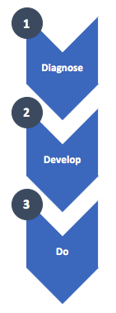
Global Implementation – 3 Key Phases
Diagnose: Use the toolkit to run country-level diagnostics of the critical constraints to women and girls’ financial inclusion for economic empowerment.
Develop: Develop recommendations for UNCDF actions at country level based on findings and analysis from country assessment; prioritize recommendations for action and relationship with existing programme activities; and identify specific partnerships required for these recommendations.
Do: Implement recommendations and partnerships through new country program activities or integration into existing program activities.

Slide 11
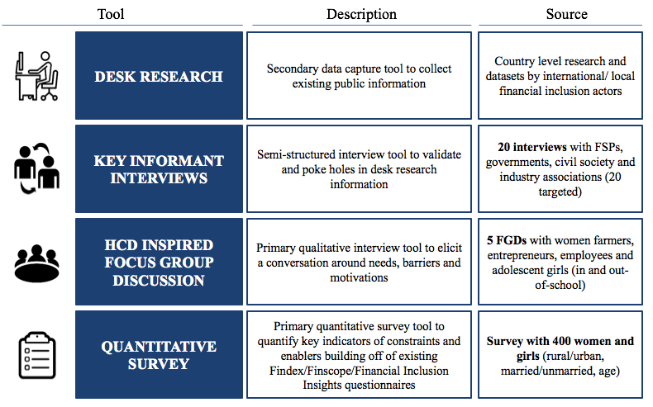
Components of Access, Usage and Agency Country Assessment Toolkit

Slide 12
Beth Porter
Beth.Porter@uncdf.org

